Slide 1
EDA MINI PROJECT - FINAL REPORT
- MUTHU KRISHNAN L

Slide 2
Unnecessary columns are dropped from dataset
We can infer from the initial part of the dataset:
1.The data had unnecessary columns such as photo, club logo, jersey number which we dropped.
2.We do not need these columns because they would not affect our further data analysis

Slide 3
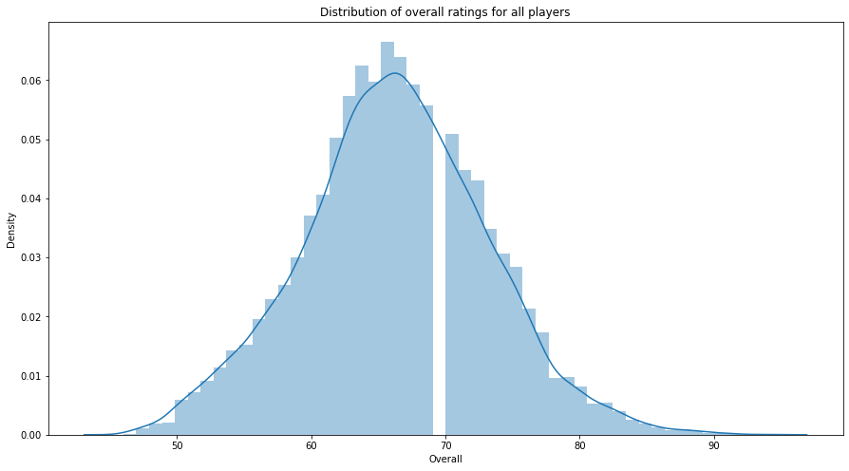
Dist plot for overall ratings
Generated dist plot for showing overall ratings of the players

Slide 4
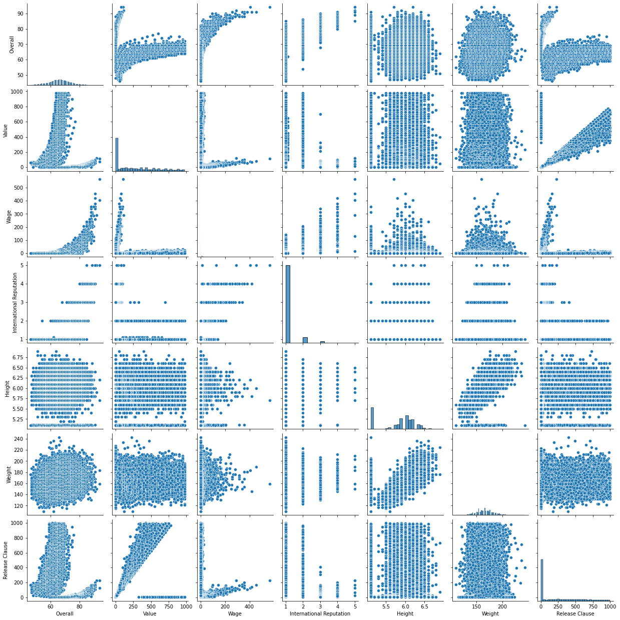
Pair Plots Generated pairplots for the data for certain columns which gave us the clear idea how features are related

Slide 5
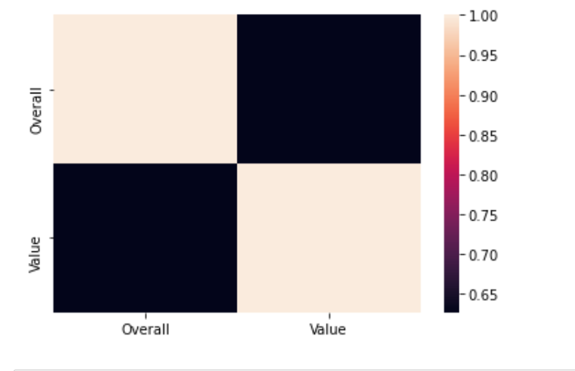
Top 20 Players
Generated a table that contains top 20 players with rank by overall score and whose contract expired in 2020
For this table calculated average wages, age ,and correlation Which came to be 0.67.
By seeing above graph we can tell that they are positively correlated.

Slide 6
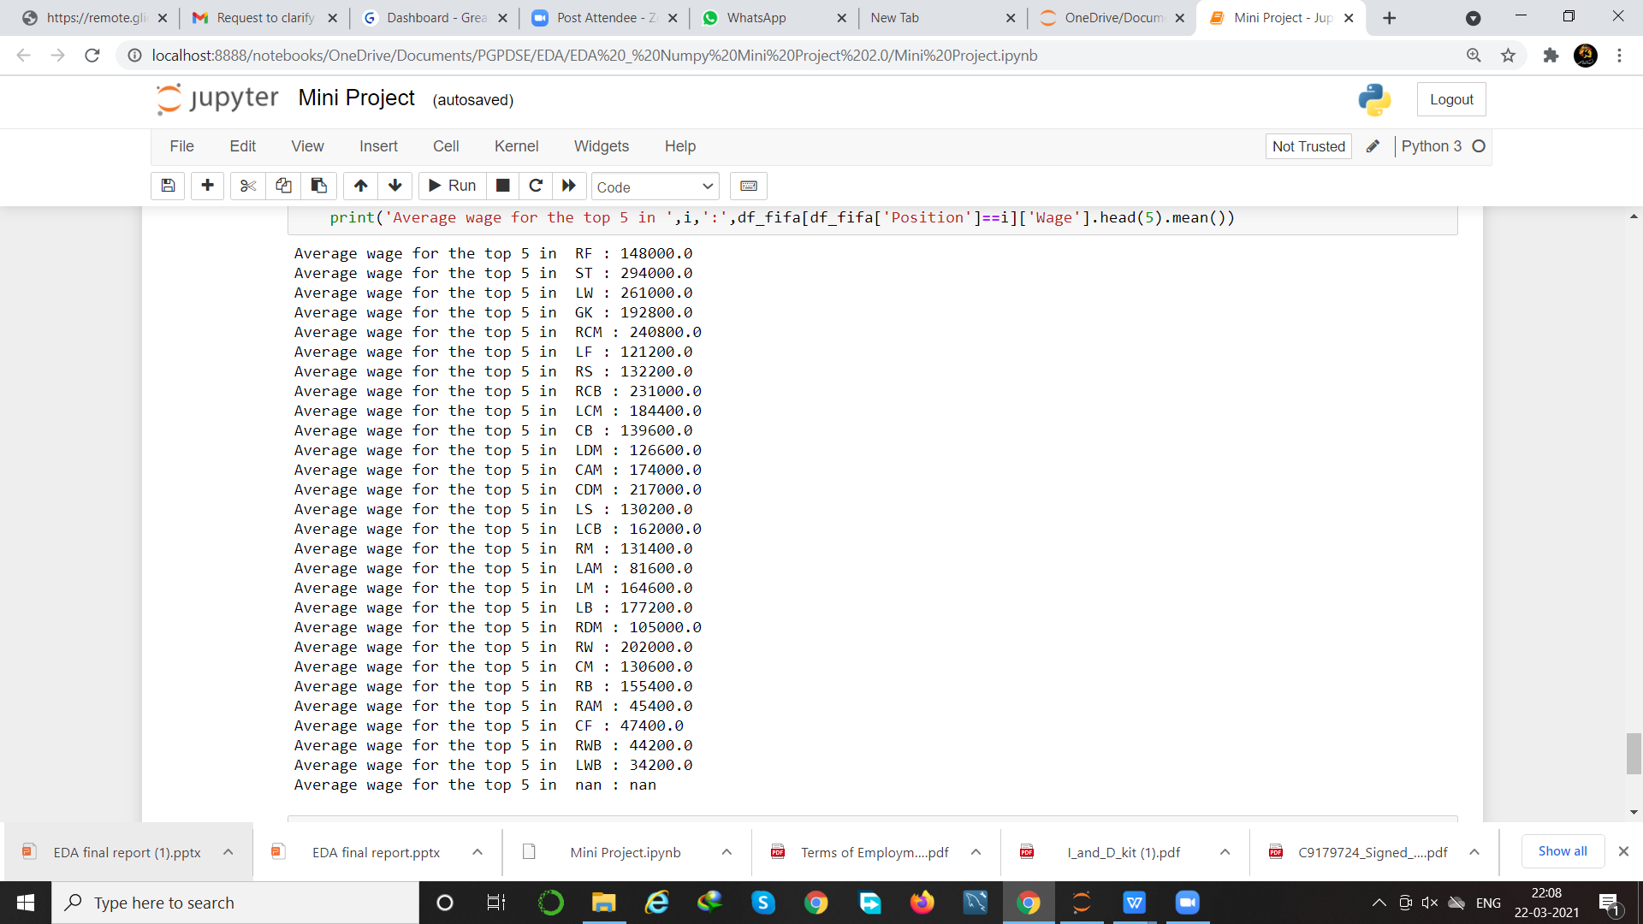
Top 5 Players
Generated a table that contains top 5 players and unique position by overall ratings.
Checked whether any player is repeated or not,but no player is repeated.
Calculated the average wages for the top 5 players in all unique positions

